Slide 1
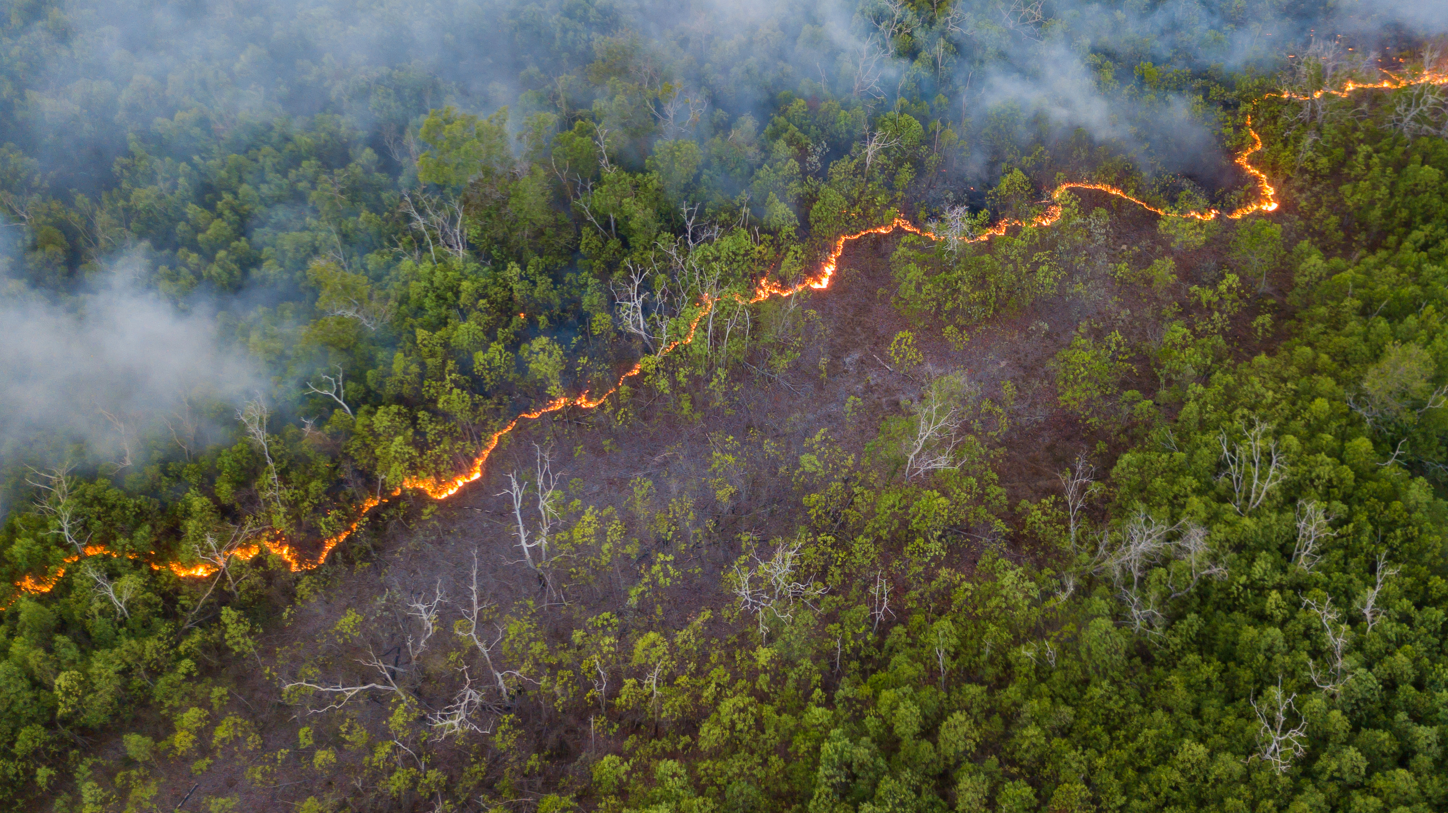
Open Data for a European Wildfire Early Warning System

Slide 2
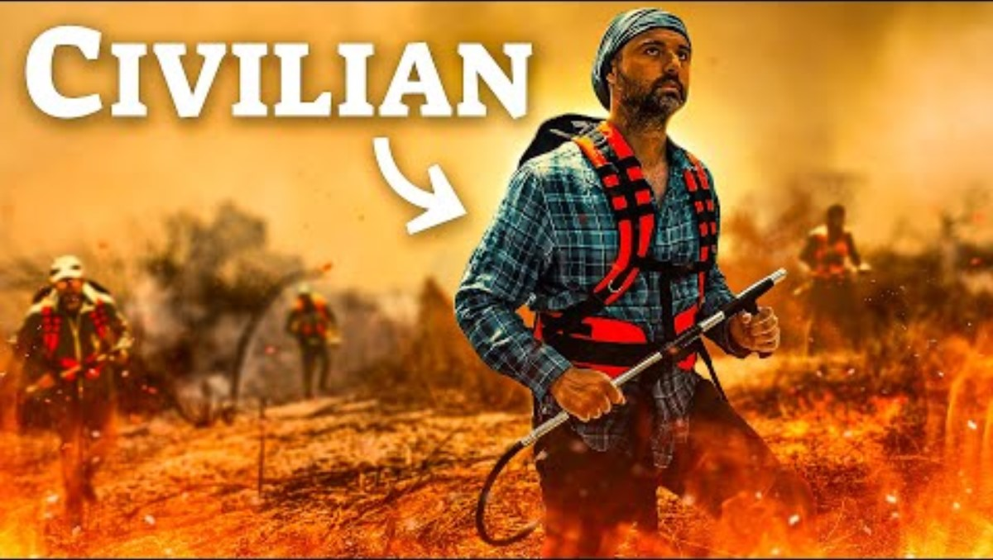
Source: Why civillians fight back wildfires in Sicily, 15-08-2023
https://www.youtube.com/watch?v=ox4dR50VMAE

Slide 3
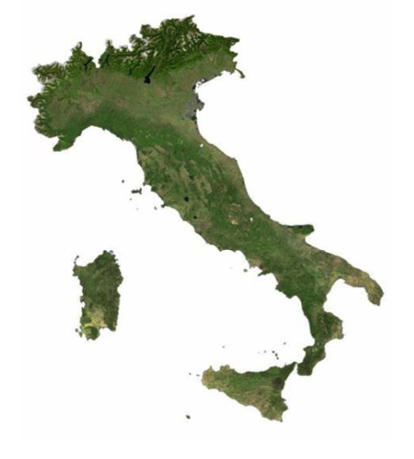
The Problem
Forest fires are a major environmental concern, affecting European hotspots such as France, Italy and Portugal annually. Effects: destruction of natural resources, wildlife habitat, local agricultural economy
Current solutions are still inefficient: rely heavily on manual observation and reports, lack of resources and political will have resulted in grassroots and civil society action
Need for improvement: early detection is the key to minimize damage - faster response times = more effective containment efforts, less damage, lives saved

Slide 4
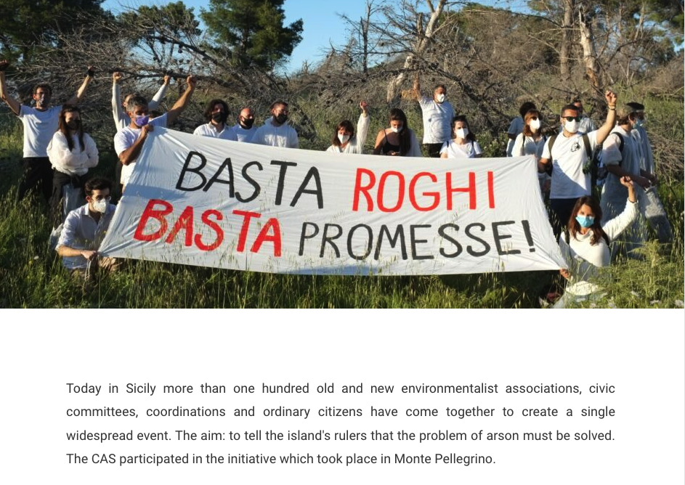
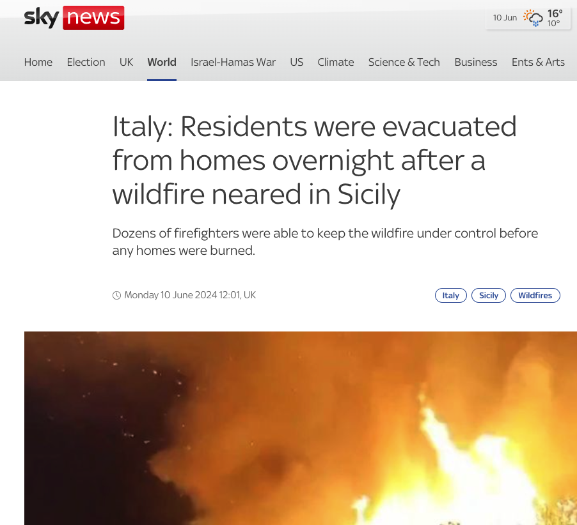
Source: Sicilian Alpine Club, 07-05-2021 https://www.clubalpinosiciliano.it/faciemu-scrusciu-a-monte-pellegrino/
Source: Sky News, 10-06-2024
https://news.sky.com/video/italy-residents-were-evacuated-from-homes-overnight-after-a-wildfire-neared-in-sicily-13150710

Slide 5


The project + timeline
Research
Problem
Objectives / Scope
Tools
Data Acquisition
Satellite Images
Weather Data
Supporting data
Data Pre-Processing
Data cleaning / normalisation
Data analysis
Development
Prototype building
Testing
Presentation
Present documentation and final results
Develop a wildfire early detection system using a Recurrent Neural Network (RNN)
Location: Italy
Open source, open data
Users: NGOs, grassroots organisations, small civil society groups with limited resources and tools

Slide 6
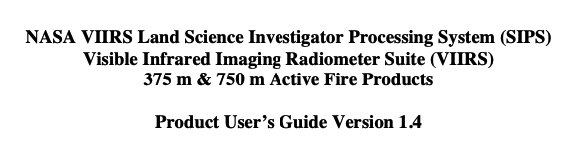

Challenges
Data Acquisition
Free and open data
temporal gaps (non-stationary satellites)
low resolution images (Sentinel 2 - 10m vs. European Space Imaging - 30cm, Planet - 3.5m)
Imagery usually with clouds making segmentation impossible
Data Processing
Spatial misalignment (varying area coverage) between datasets
Bias from training a model with images where the fire is always centered
Etc
Organisation - team planning and time
Reading, learning

Slide 7

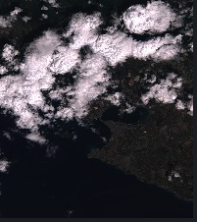
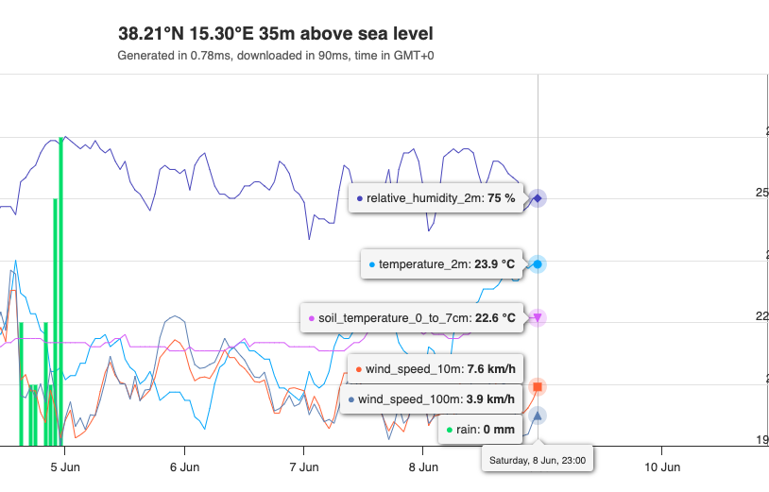
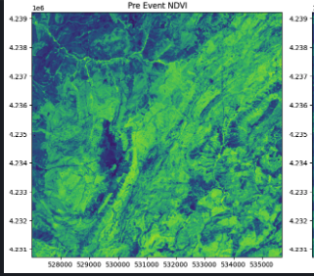
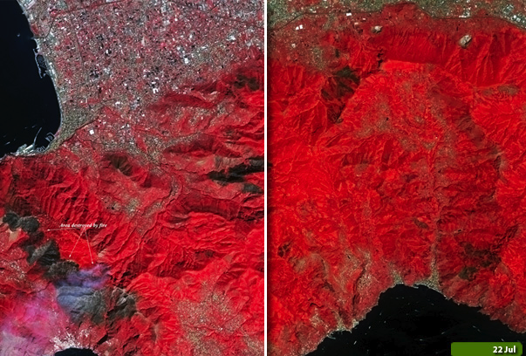
Satellite and weather data
Sentinel Hub
Sentinel 2: higher frequency, infrared bands
Landsat 8: thermal bands, lower resolution and frequency

Slide 8
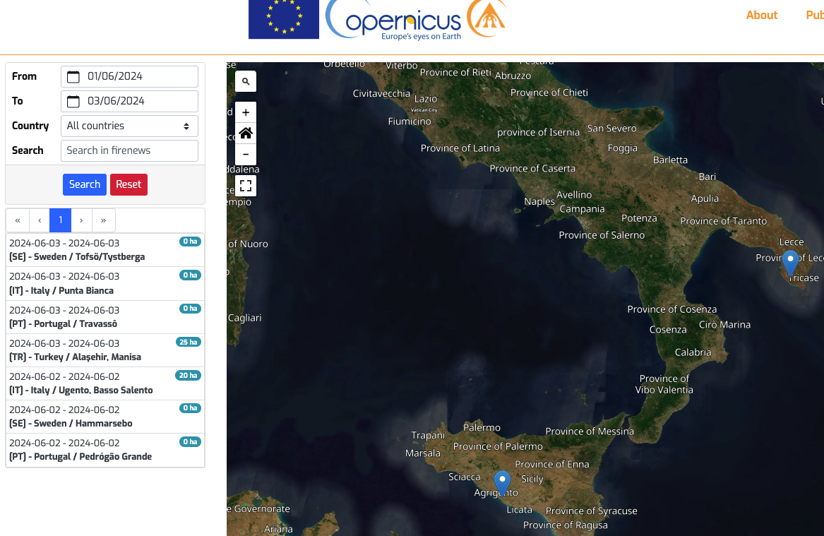
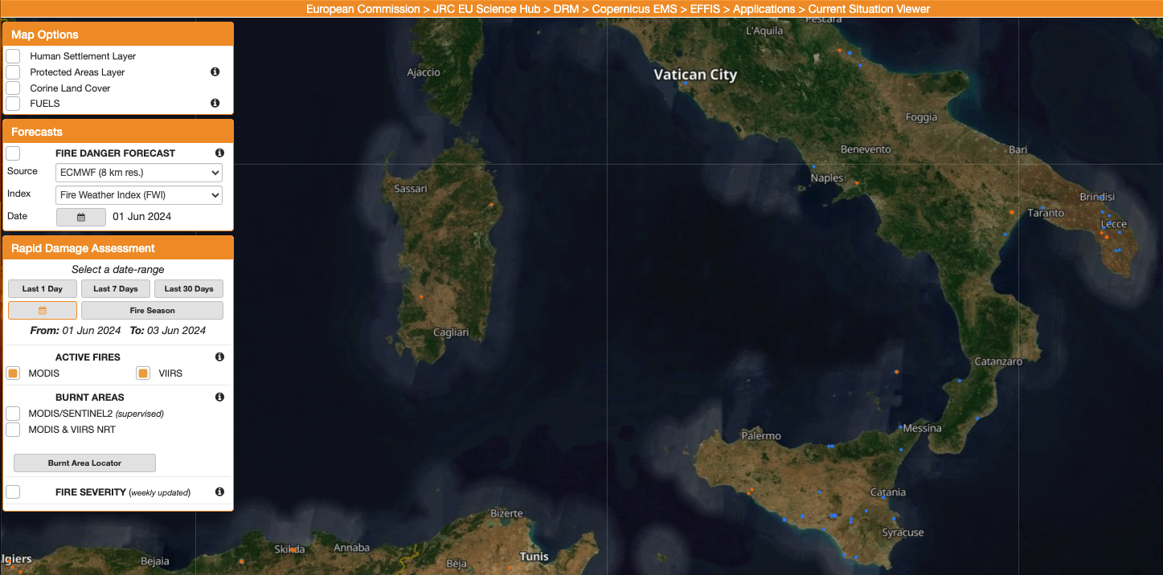
Obtaining Labels
When did fires occur?
Copernicus Firenews – maps fires reported in the news
not all wildfires reported, no reporting during winter months, heavily dependent on news trends (Source: External consultant for the European Commission (Engineering S.p.A))
Copernicus Active Fire Detection - combines two sensor systems
MODIS sensor identifies areas on the ground that distinctly hotter than their surroundings and flags them as active fires + The VIIRS (Visible Infrared Imaging Radiometer Suite) uses similar algorithms to those used by MODIS to detect active fires)

Slide 9
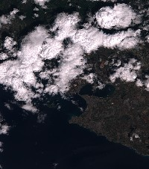



goal
40.50, 17.21​ 17/06/23​
​

Slide 10
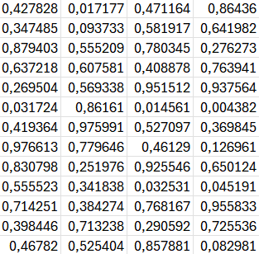
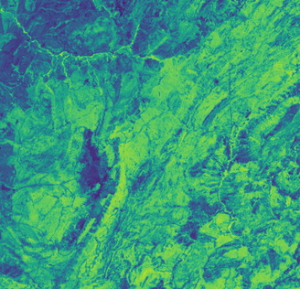
RNN model - words
Torch.Tensor representation
40.50, 17.21​ 17/06/23​
​

Slide 11
RNN model- sentence
40.50, 17.21 17/06/23
40.50, 17.21 18/06/23
40.50, 17.21 19/06/23
40.50, 17.21 20/06/23
Torch.Tensor representation
Torch.Tensor representation
Torch.Tensor representation
Torch.Tensor representation

Slide 12
Data enhancements to improve model robustness
challenge | solution
Data is centered, real life aren't | Crop image and noise coordinates
Overlap in data with miss-labels | Find and reconnect coordinates

Slide 13
Next steps
11/06/24 | 18/06/24 | 25/06/24 | 02/07/24
Data cleaning (uniform shape and area, correct wrong data, find nearby points and unite them, etc...) | Data enhancements (introduce negative examples, make the model robust to small changes, perturbations) | Training the model on the dataset, testing results | Final Presentation
Data enhancements (negative examples, making the model robust to small changes, moving center\rotation) | Documentation and Reproducibility | Documentation and reproducibility
Design Model | Hyperparameter Tuning | Final fixes, repo cleanup
Start documentation | Start Final Presentation

Slide 14

Thank you
Questions?

